Slide 1

CS-M151B
Computer Systems Architecture
Blaise Tine
UCLA Computer Science

Slide 2
Agenda
About me
Logistic
Q/A
Course Introduction

Slide 3
About me
Name: Blaise-Pascal Tine
Email: blaisetine@cs.ucla.edu
DM me on campuswire
Office Hours: Fridays 4:30-5:30 PM
Location: Eng VI 499
in-person or remote

Slide 4
About me
Research Interests
Custom hardware extensions for GPU
Graphics, ML, security, etc…
ISA extensions
Compiler optimizations
Custom hardware extensions for FPGAs
High-Level Synthesis for hardware design
Hardware design automation
Looking a fun H/W research project? – email me

Slide 5


About me
Country of origin: Cameroon
First language: French, Ngemba
My hobbies:
Painting: oil, acrylic, digital
Programming:
Old school: Pascal, BASIC
Web: HTML5, Javascript
Managed: Java, C#
Interpreted: Python
Native: C/C++
Hardware: Verilog, VHDL
Acrylic

Slide 6
Teaching Assistant
TA: Turan Vural
Email: turan@g.ucla.edu
Office Hours: Wednesdays

Slide 7
Tell us about you
School/Department
Background
Why are you taking this course?
Project partner
Form: https://forms.gle/rJjMRQAJ5e8pp1B1A

Slide 8
Course Syllabus
Course website: https://blaisetine.github.io/m151b
Computer Model, Abstractions, and Technologies
Processor Design Metrics and Objectives
Instruction Set Architecture Design
Pipelining
Data and Controls Hazards
Branch Prediction
Super-Scalar Processors and Out-of-Order Execution
Cache and Memory Hierarchy
Power Management
Advanced Topics: GPUs, Accelerators, and Custom Architectures

Slide 9
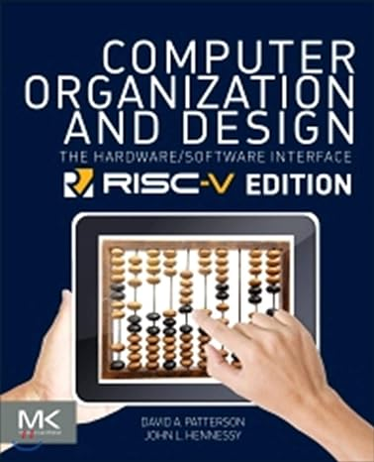
Reading Material
Book
David A. Patterson and John L. Hennessy, Computer Organization and Design: the Hardware/Software Interface: RISC-V Edition.
Additional Course Materials
Will be provided by the instructor.

Slide 10
Campuswire
Self enrollment
Check out Bruinlearn’s syllabus section
Encourage participation with bonus points
TA and I will regularly check

Slide 11
Waiting List
The class is full!
Overflow 95/80
You can audit the course!

Slide 12
Homework
6 homework assignments
Individual work
Submitted by midnight on Thursday or Friday morning.
Due the following Thursday before class.
Multiple choice tests
5 pts each

Slide 13
Projects
2 projects
CPU pipeline implementation and optimization
Required knowledge of C++
3 weeks duration
Group project: teams of 2
Can be done individually if you prefer to work solo
Encourage teamwork
Most learn better from peers
Most understand better by explaining to someone else
Separate submission
Must submit the same work you did with your partner
15 pts each

Slide 14
Exams
Mid-term on 02/08/2024 – 15 pts
Final on 03/19/2024 – 20 pts
Use computer in class
Will offer a review session

Slide 15

Participation
In class attendance
Check attendance via QR code
At least 70%
In class participation
Will hand out a form before the final
Campuswire participation
5 pts (50% attendance, 50% participation)

Slide 16
Grading
30% Homework
30% Projects
15% Midterm
20% Final
5% Participation
Distribution
A: 90+
B: 80+
C: 70+

Slide 17
Policies
Late Assignment: Not allow
Except Dean of student approval
Bad submission: -5% of the grade
Wrong file name
Missing files
Regrade
Must request within a week
Written justification
Be aware of full regrade!

Slide 18
Q & A
7 minutes recess

Slide 19
Class Assignment
In which ways Apple M1 chip better than Intel core i9 and AMD Ryzen processors?
How do you explain the Apple M1 chip success?
Why is everybody not using Apple M1?

Slide 20
Class Assignment
In which ways is the Apple M1 chip better than Intel Core i9 and AMD Ryzen processors?
How would you explain the success of the Apple M1 chip?
Why isn't everyone using the Apple M1?

Slide 21
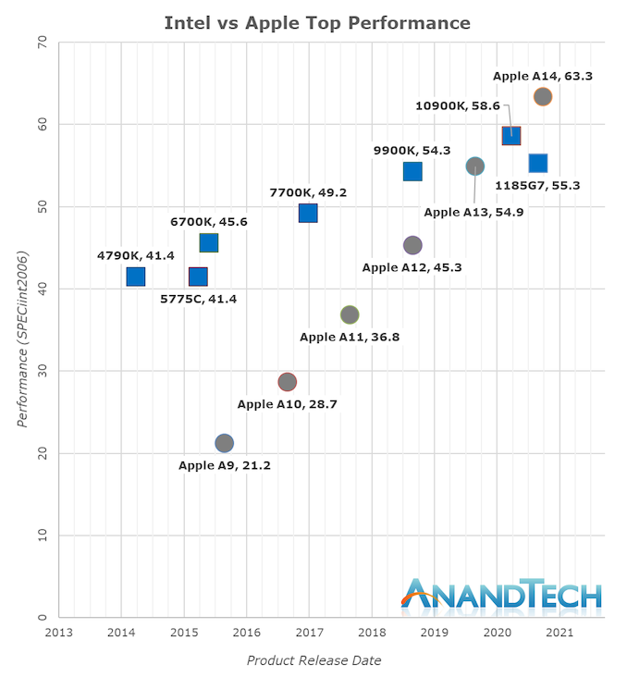
Apple Chip Progression
From a mobile (phone) to desktop (MAC)
Single-thread performance Increase (2015-2021)
Intel ~28%
Apple ~198% or 2.98x
Intel still has an edge on single thread
https://www.anandtech.com/show/16226/apple-silicon-m1-a14-deep-dive/4
Notes:
* Intel Core i7-1185G7 (4-cores) was relatively weaker than Intel Core i7-11850H (8-cores)

Slide 22
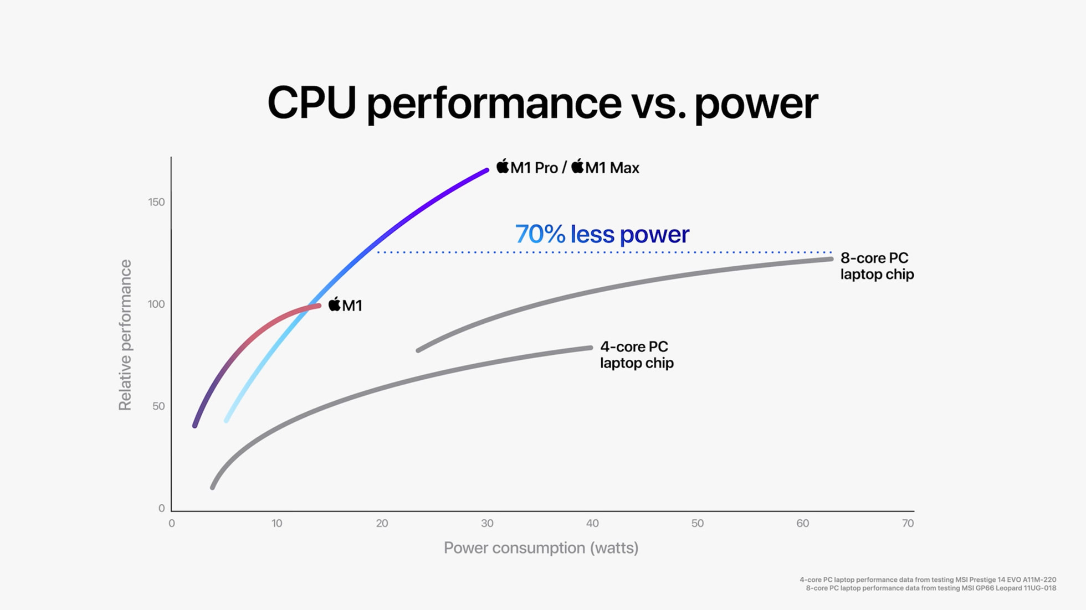
Apple M1 Efficiency
70% less power for same performance compared to competition!
Performance per watt (flops per watt)
How did they get here?
https://www.apple.com
Notes:
https://www.apple.com/newsroom/2021/10/introducing-m1-pro-and-m1-max-the-most-powerful-chips-apple-has-ever-built

Slide 23
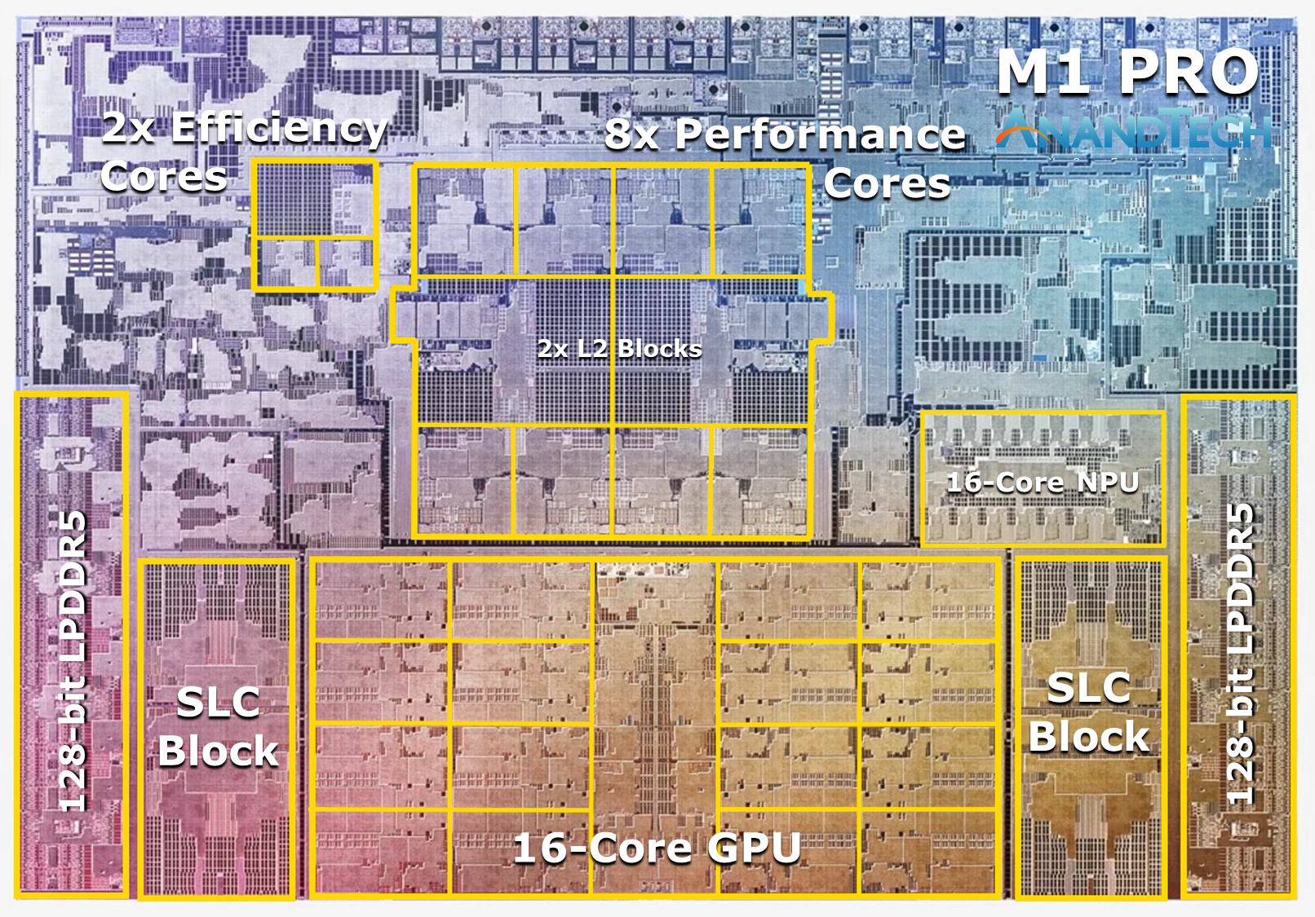
Apple M1 PRO Chip layout
Hybrid architecture
Efficient cores
Performance cores
Neural Processing Units
Internal DDR memory
Shared GPU-CPU memory
SLC (system-level cache)
Notes:
https://www.apple.com/newsroom/2021/10/introducing-m1-pro-and-m1-max-the-most-powerful-chips-apple-has-ever-built/

Slide 24
Apple silicon characteristics
Instruction set architecture (ISA)
ARM ISA
RISC architecture advantages
Smaller instructions set
Simpler pipeline
efficient decode. Execute
Energy efficient processor
Easier compiler optimizations
RISC challenges
More instructions per work
e.g. memory operations
CISC single-thread advantage
Notes:
RISC => relaxed instruction set computer
X86 ALU memory operands

Slide 25
Apple silicon characteristics
Process Technology
5 nanometer for M1 chip from TSMC
Intel was still on 3rd generation 10 nm
Why it matter?
Higher transistor density
More cores per area => more flops per area
Higher clock speed due to shorter delay
Notes:
TSMC (Taiwan semiconductor manufacturing company)
NM is the size of the smallest feature that can be reliably manufactured in a chip's fabrication process.
In the early days of semiconductor manufacturing, the "nm" measure was more closely aligned with the length of the silicon channel between the source and drain of the transistor.

Slide 26
Apple silicon characteristics
Integrated components
Reduce communication overhead
Increase energy efficiency
Increase communication bandwidth
Bypass pins shortage
Integrated GPU
Integrated SSD controller
Notes:
TSMC (Taiwan semiconductor manufacturing company)
Higher clock speed => smaller transistor device, short delay

Slide 27
Apple silicon characteristics
Near Memory Computing
Integrated Memory
Reduce memory latency
Reduce communication overhead
Increase energy efficiency
Increase communication bandwidth
Bypass pins shortage
Notes:
TSMC (Taiwan semiconductor manufacturing company)
Higher clock speed => smaller transistor device, short delay

Slide 28
Apple silicon characteristics
Hardware specialization
Move common expensive tasks into silicon
Increase energy efficiency
Neural processing units (NPUs) (AI)
Media encode/decode engines (video, images)
Notes:
TSMC (Taiwan semiconductor manufacturing company)
Higher clock speed => smaller transistor device, short delay

Slide 29
Apple silicon characteristics
Heterogenous computing
Little cores and big cores
high-performance "Firestorm" cores
high-efficiency "Icestorm" cores
optimize for performance or power efficiency as needed
Notes:
TSMC (Taiwan semiconductor manufacturing company)
Higher clock speed => smaller transistor device, short delay

Slide 30
Apple silicon characteristics
Microarchitecture optimizations
Unified memory
CPU and GPU share the same memory pool
Eliminates unnecessary copies
Larger pool increases capacity / utilization
Notes:
TSMC (Taiwan semiconductor manufacturing company)
Higher clock speed => smaller transistor device, short delay

Slide 31
Apple silicon characteristics
Hardware-software codesign
Apple own both the hardware and system stack
allows for tight integration
Controlled ecosystem of critical applications
Profiling and optimizations
Notes:
TSMC (Taiwan semiconductor manufacturing company)
Higher clock speed => smaller transistor device, short delay

Slide 32
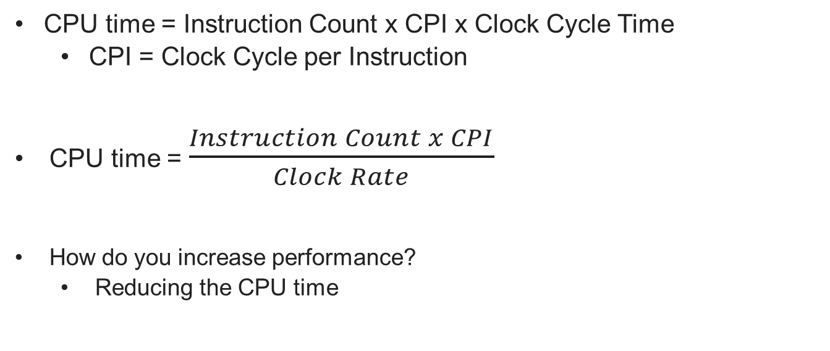
The Classic CPU Performance Equation
CPU time = Instruction Count x CPI x Clock Cycle Time
CPI = Clock Cycle per Instruction
CPU time = $\frac{Instruction Count x CPI}{Clock Rate}$
How do you increase performance?
Reducing the CPU time
SPECint benchmarks – Patterson & Hennessy book
Notes:
VAX-11/780, was announced in October 1977 at 5 Mhz, 32-bit

Slide 33
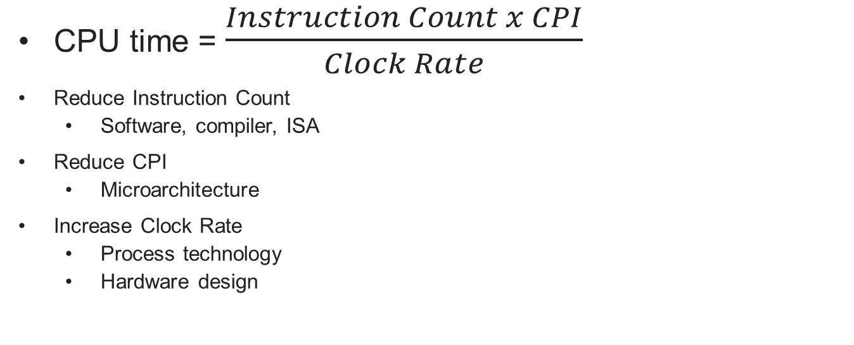
Reducing CPU Time
CPU time = $\frac{Instruction Count x CPI}{Clock Rate}$
Reduce Instruction Count
Software, compiler, ISA
Reduce CPI
Microarchitecture
Increase Clock Rate
Process technology
Hardware design

Slide 34
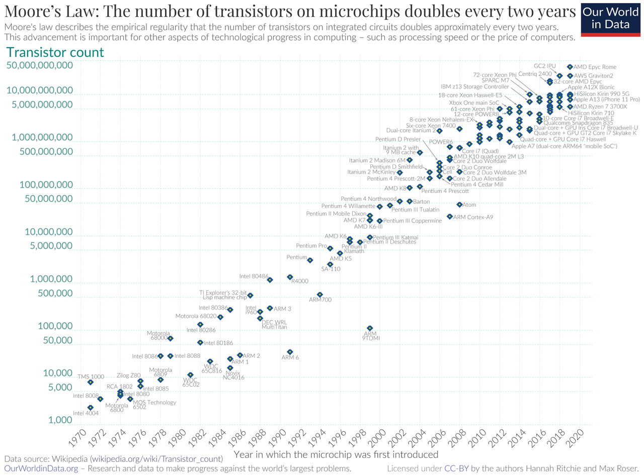
Moore’s law
Gordon Moore predicted in 1965’s the doubling of transistors count every two years.
His prediction was fairly accurate in the decades that followed up to the 2010’s

Slide 35
Dennard’s (MOSFET) Scaling
Dynamic Power = alpha * CFV²
Alpha = transistor switching rate (represents how active the transistor is)
^{C = capacitance}
^{F = frequency}
^{V = voltage}
Dennard’s scaling (1974)
As transistors get smaller the capacitance and voltage decreases
So, you can increase frequency while keeping the power constant
Higher frequency means higher performance
Notes:
Alpha is also called activity factor of the transistor
Capacitance = capacity for storing electric charge

Slide 36
Breakdown of Dennard’s Scaling (2006)
As transistors got too small
Leakage current between transistor gate
Threshold voltage couldn’t be reduced further
Higher power density (watt/mm²⁾
Heat dissipation from densely packed transistors
Instability of transistors when approaching atomic scale
Notes:
Robert Dennard
Capacitance = capacity for storing electric charge
Voltage = electric charge of a circuit
Power density = power per unit area (Watt/mm2)

Slide 37
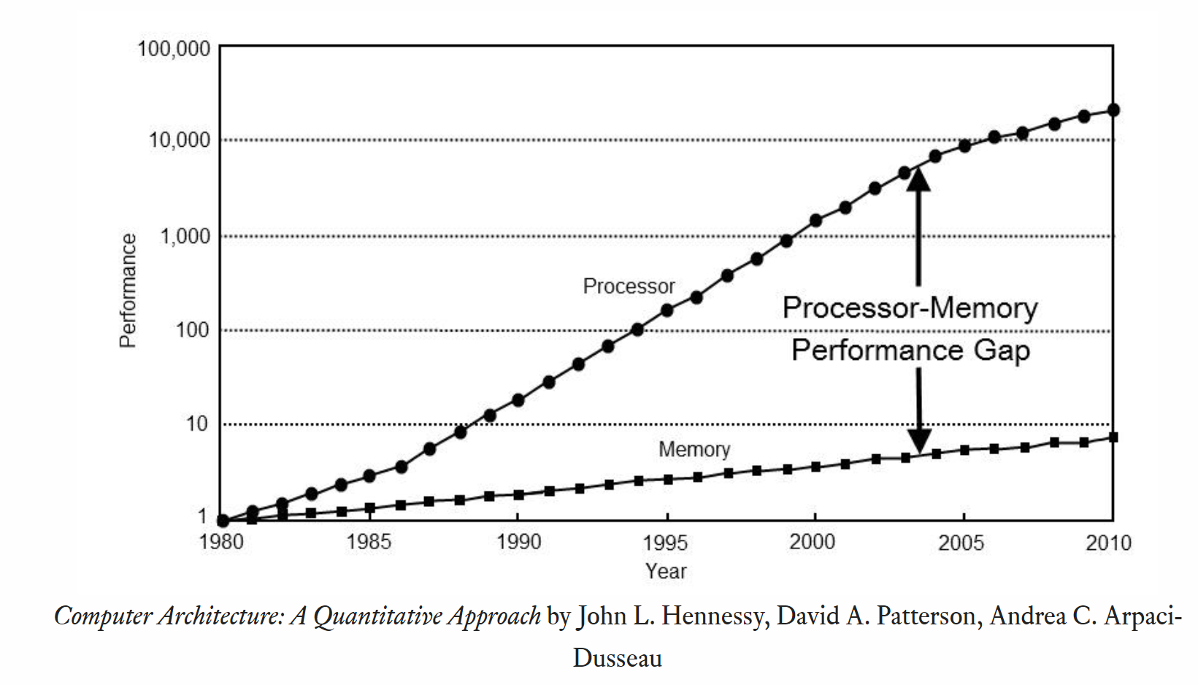
Memory Wall
DRAW technology scaling
Is slower than processor’s
slower clock than CPU’s
Memory Latency
Getting data from memory
Takes more CPU cycles
Multi-core area
Increases memory requests
Increases demand on memory bandwidth

Slide 38
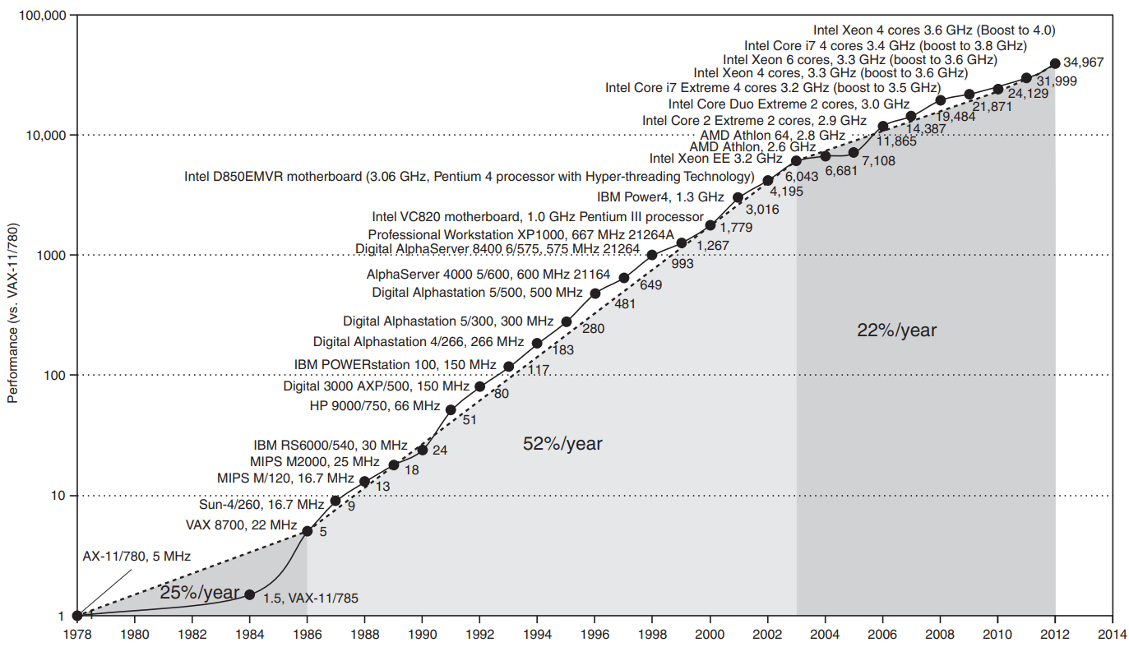
The big picture
-1984
Process technology
1984-2004
Process technology
Microarchitecture optimizations
2004+
Power wall
Memory wall
ILP wall
SPECint benchmarks – Patterson & Hennessy book
Notes:
VAX-11/780, was announced in October 1977 at 5 Mhz, 32-bit

Slide 39
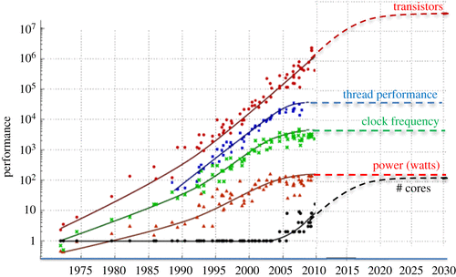
The end of Moore’s Law
Multicore Area
Increase the number of cores
Kunle Olukotun, Lance Hammond, Herb Sutter, Mark Horowitz and extended by John Shalf.
Notes:
VAX-11/780, was announced in October 1977 at 5 Mhz, 32-bit

Slide 40
Multicore area challenges
Limitations application parallelism
Inter-core communication
Memory wall
Heat dissipation
Power management
Physical limits
Kunle Olukotun, Lance Hammond, Herb Sutter, Mark Horowitz and extended by John Shalf.

Slide 41
Great area for computer architects
How do we continue to scale performance?
It will require a holistic approach
At all layers of the computing stack
Technology nodes
Microarchitecture
Compilers
Systems and Applications
The progress won’t stop ;-)

Slide 42
What we will learn in this class
The fundamentals of computer architecture
Understand the design decisions when building a processor
How to simulate and evaluate a processor

